Slide 1
Advanced Front-End Programming (CPAN 144)
Week 3
Lecturer: Harshdeep Singh
Winter 2023

Slide 2
Agenda
JavaScript Framework and Libraries
What is React?
React Environment Setup

Slide 3
JAVASCRIPT LIBRARY VS FRAMEWORK

Slide 4
JavaScript Library
A library is a JavaScript file that contains a bunch of functions, and those functions accomplish some useful task for your webpage
JavaScript libraries can be added to a webpage using <script src=“library.js”> </script>
Here is the list of JS libraries
https://en.wikipedia.org/wiki/List_of_JavaScript_libraries
Some example of JavaScript Libraries:
jQuery
Moment.js
Lodash

Slide 5
JavaScript Framework
A JavaScript framework is an application framework written in JavaScript that helps you create a web app in a more efficient way
Unlike a library, frameworks come with their own set of rules that you have to follow

Slide 6
JavaScript Framework
Frameworks are more popular for the designing of websites
Famous JavaScript frameworks
Angular
Vue
React?
Learn more about frameworks:
https://www.youtube.com/watch?v=VbvMJUpY0a4

Slide 7
INTRODUCTION TO REACT

Slide 8
What is React
React is a JavaScript library/framework created by Facebook(now Meta) for creating user interfaces.
Official webpage: https://react.dev/

Slide 9
Steps for setting up a React Environment
Install NPM and Node.js
Install the create-react-app
Create the first-react-application!
Run the React Application
We are going to complete these steps in a few minutes, but before that, let's understand each step in more detail

Slide 10
What is NPM?
npm : Node Package Manager
What is a package?
A package in Node.js contains all the files you need for a module.
What is Module?
Modules are JavaScript libraries you can include in your project.
npm is a great way to download, install, and keep track of JavaScript software.
https://www.npmjs.com/

Slide 11
What is Node.JS
npm is installed with Node.js
Node. js is an environment for developing server-side applications.
At the time of its creation, javascript could only be run on browsers(unlike other languages)
Node.JS was created to take JS out of the browser
https://nodejs.org/en

Slide 12
What is create-react-app
create-react-app is a tool (built by developers at Facebook) that gives you a massive head start when building React apps.
It saves you from time-consuming setup and configuration.
You simply run one command and Create React App sets up the tools you need to start your React project.
https://create-react-app.dev/

Slide 13
Activity 1: Setup React Environment
We are going to install Node.js and npm and set up the React environment on your machine.
Download the instruction from the BB -> Course Document -> Weekly Content -> Week 3 -> instructions.docx
Create the 1st react app as per given instruction
Modify the output of the app by adding your name some where in the output page

Slide 14
What is React Developer Tools
React Developer Tools is a Chrome DevTools extension for the open-source React JavaScript library.
It allows you to inspect the React component hierarchies in the Chrome Developer Tools.

Slide 15
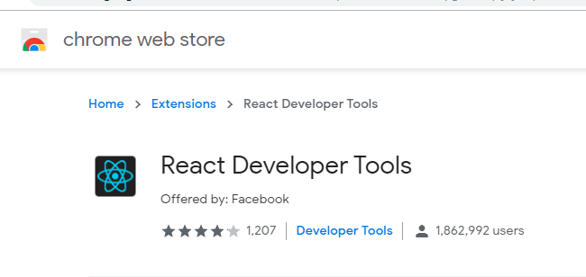
Add React Developer tool extension to your browser

Slide 16
React Project Structure

Slide 17
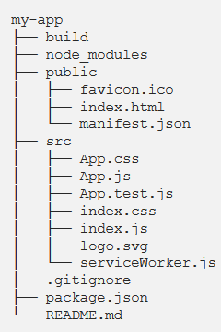
File structure created by create-react-app
build is the location of your final, production-ready build.
node_modules is where packages installed by NPM will reside.
public is where your static files reside
src is where all your Javascript lives

Slide 18
File structure created by create-react-app
Some important files we’ll be working with extensively
public/index.html: When the application starts this is the first page that is loaded.
This will be the only html file in the entire application
This file has a line of code <div id=”root”></div>. This line is very significant since all the application components are loaded into this div.

Slide 19
File structure created by create-react-app
src/index.js: This is the javascript file corresponding to index.html. This file has the following line of code which is very significant.
root.render(<App />)
The above line of code is telling that App Component ( will cover App Component soon) has to be loaded into an html element with id root. This is nothing but the div element present in index.html.
src/index.css: The CSS file corresponding to index.js.

Slide 20
Basic Folder Structure
src/App.js : This is the file for App Component.
App Component is the main component in React which acts as a container for all other components.
src/App.css : This is the CSS file corresponding to App Component

Slide 21
File structure created by create-react-app
index.js is the actual entry point for all react apps and it just has code of what to render and where to render.
App.js has the root component of the react app
The <App /> is the top most component in hierarchy. This gives you feel that you maintain hierarchy in your code starting from App.js.

Slide 22
The Render Function
In your index.js file, you may notice that you have the following code:
import ReactDOM from 'react-dom/client';
const root = ReactDOM.createRoot(document.getElementById('root'));
root.render(
<React.StrictMode>
<App />
</React.StrictMode>
);
createRoot is a function and part of the ReactDOM that takes an HTML element and renders the content of your app inside that HTML element
The render() function will take the root component of your app and will render it inside the html element you defined in createRoot() function.

Slide 23
Activity
Submit a screenshot of your browser screen with your project running

Slide 24
Submit your class Activities
Navigate to Course Content -> Assessments -> Labs -> Lab 3 and download the instruction for lab 1.
Once you fulfill all the requirements of the lab ZIP all your source files and submit them into Course Content -> Assessments -> Labs -> Lab 3
Pay attention to the due date defined on the blackboard submission box for this activity.

